Slide 1
Data Science and Openshift on the MOC
Mentors
Michael Clifford, RedHat Inc.
Anand Sanmukhani, RedHat Inc.
Team
Yousif Khaireddin
Zhuofa (Marco) Chen
Krishna Palle
Fangya Xu
Nihar Dwivedi
Ojasvi Jhamb
Notes:
Ojasvi

Slide 2
Goals
Deploying Prometheus Anomaly Detection (PAD) onto DataHub
Building machine learning models to extend PAD
Testing the Pipeline, Flow of Data/Information and finding the bugs
Notes:
Ojasvi

Slide 3
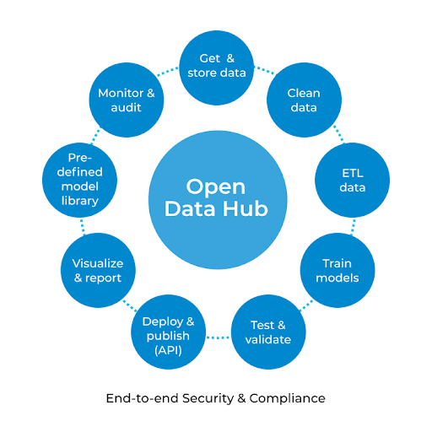
Data Hub
An open source project that provides open source AI tools for running large and distributed AI workloads on OpenShift Container Platform
Components
Apache Spark
JupyterHub
Prometheus
Grafana
Argo
Seldon
https://next.redhat.com/2018/09/19/a-hub-for-open-data-at-mass-open-cloud/
Notes:
Yousif
Apache Spark is an open-source distributed general-purpose cluster-computing framework. Spark provides an interface for programming entire clusters with implicit data parallelism and fault tolerance.

Slide 4
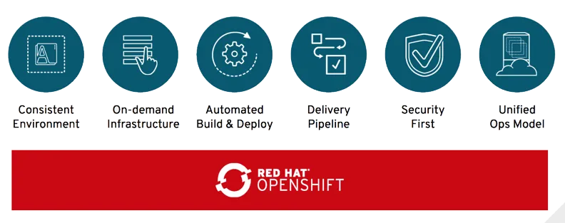
OpenShift
OpenShift is a family of containerization software developed by Red Hat.
It is a platform as a service built around docker containers orchestrated and managed by Kubernetes on a foundation of Red Hat Enterprise Linux.
https://blog.openshift.com/red-hat-openshift-and-microsoft-windows-containers/
Notes:
Marco

Slide 5
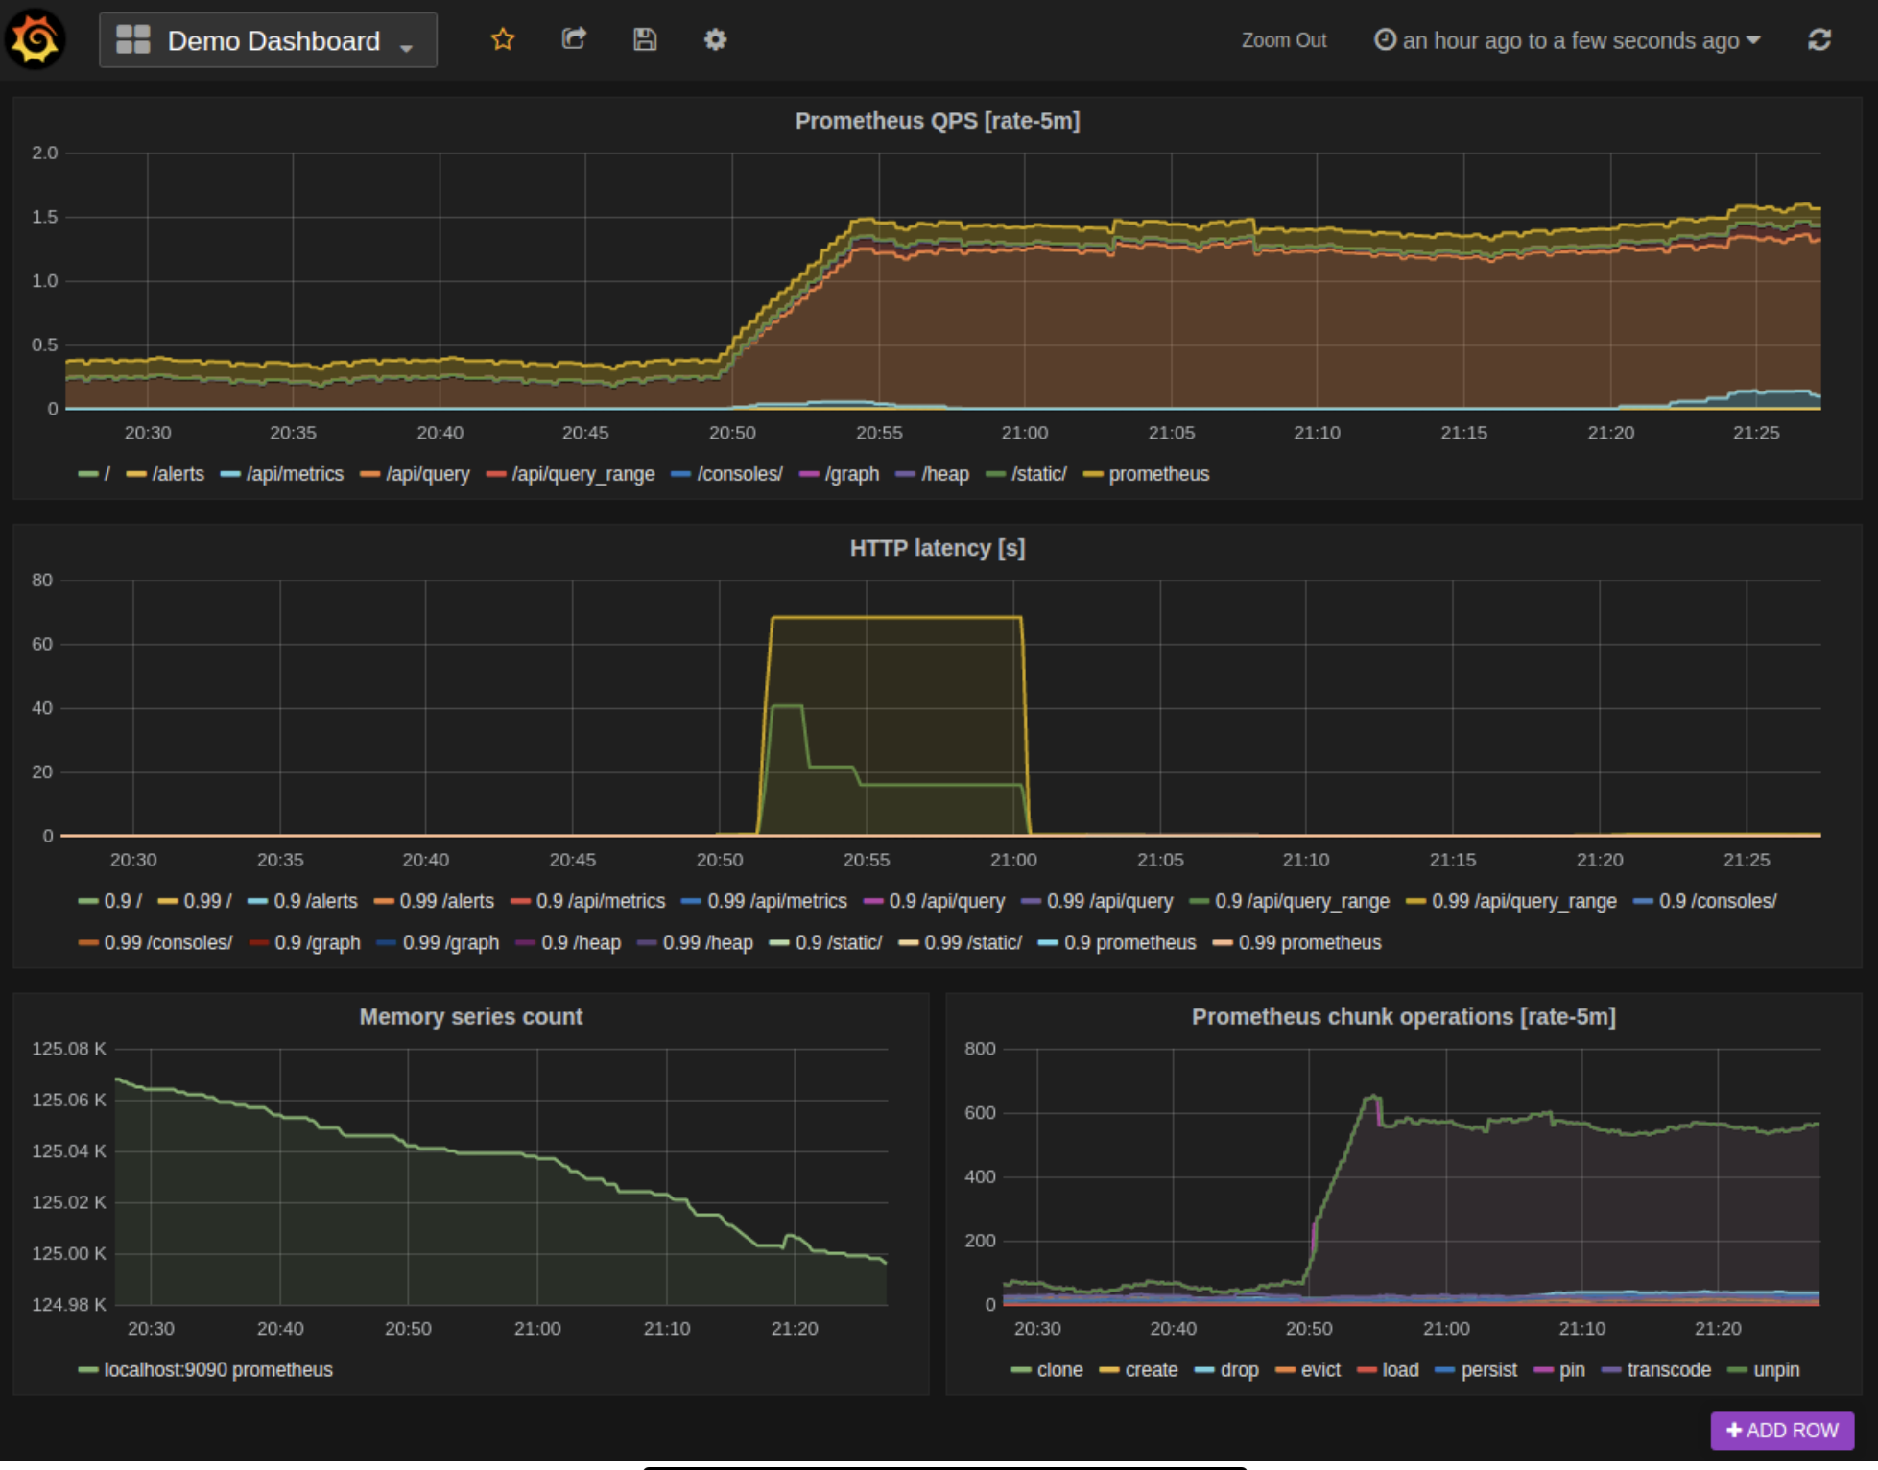
Prometheus
Prometheus is an open-source systems monitoring and alerting toolkit which scraps time series data from the metrics file of the application and builds a time series database.
It implements high dimensional data models, equips the user with promQL, visualization tools, high storage and easy integration with extensive library support.
All data visualization is done on Grafana
https://prometheus.io/docs/visualization/grafana/
Notes:
Fangya

Slide 6
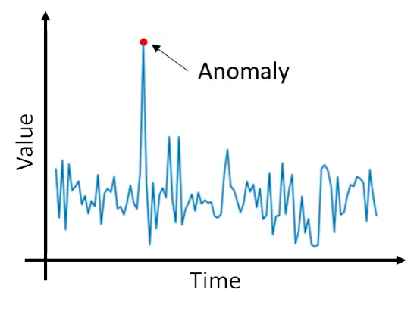
Prometheus Anomaly Detection
An existing open-source project developed by the AI team at Red Hat to analyze time-series data generated by cloud infrastructure
This application leverages machine learning algorithms to perform time series forecasting and predict anomalous behavior in the metrics.
The predicted values are compared with the actual values and if they differ from the default threshold values, it is flagged as an anomaly.
https://www.engineering.com/AdvancedManufacturing/ArticleID/19058/Anomaly-Detection-Industrial-Asset-Insights-Without-Historical-Data.aspx
Notes:
Krishna

Slide 7
Five
Compare the collected real time data to the predicted data and flag alomolies
One
Collects time series data from Prometheus
PAD Workflow
Four
Collect the real time data from Prometheus
Two
Builds a data set by representing the data as
Prophet
Fourier
Three
Predict time series data for the future using the dataset
Notes:
Krishna

Slide 8


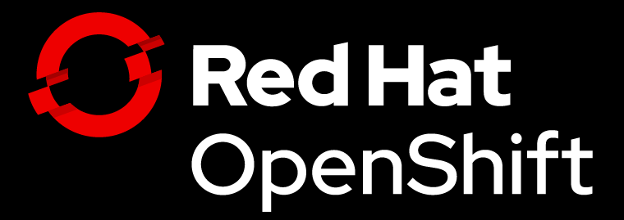

Sprint Progress
Project Familiarization
Our task for the first sprint consisted of familiarizing ourselves with the Mass Open Cloud, Openshift, Kubernetes, Open Data Hub and Prometheus Anomaly Detection.
Openshift Tutorial
We went through a tutorial for OpenShift, which taught us the basic shell commands and introduced us to the workflow of running an OpenShift cluster.
VM Setup
We setup virtual machines with fedora images, and set up the openshift environment that we’ll be using for further development.
Notes:
Nihar
Explaining our VM work and why we need it

Slide 9
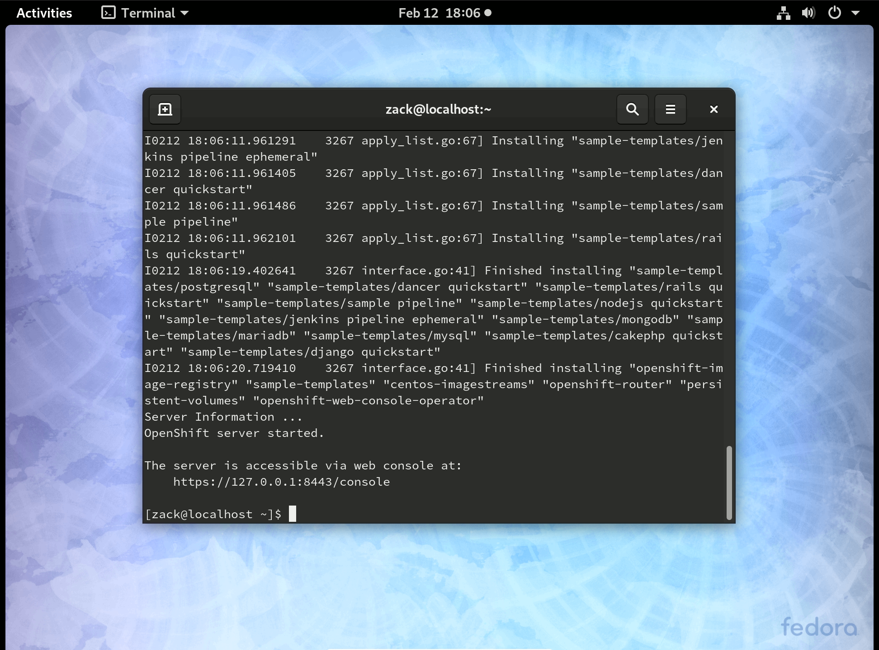

Slide 10
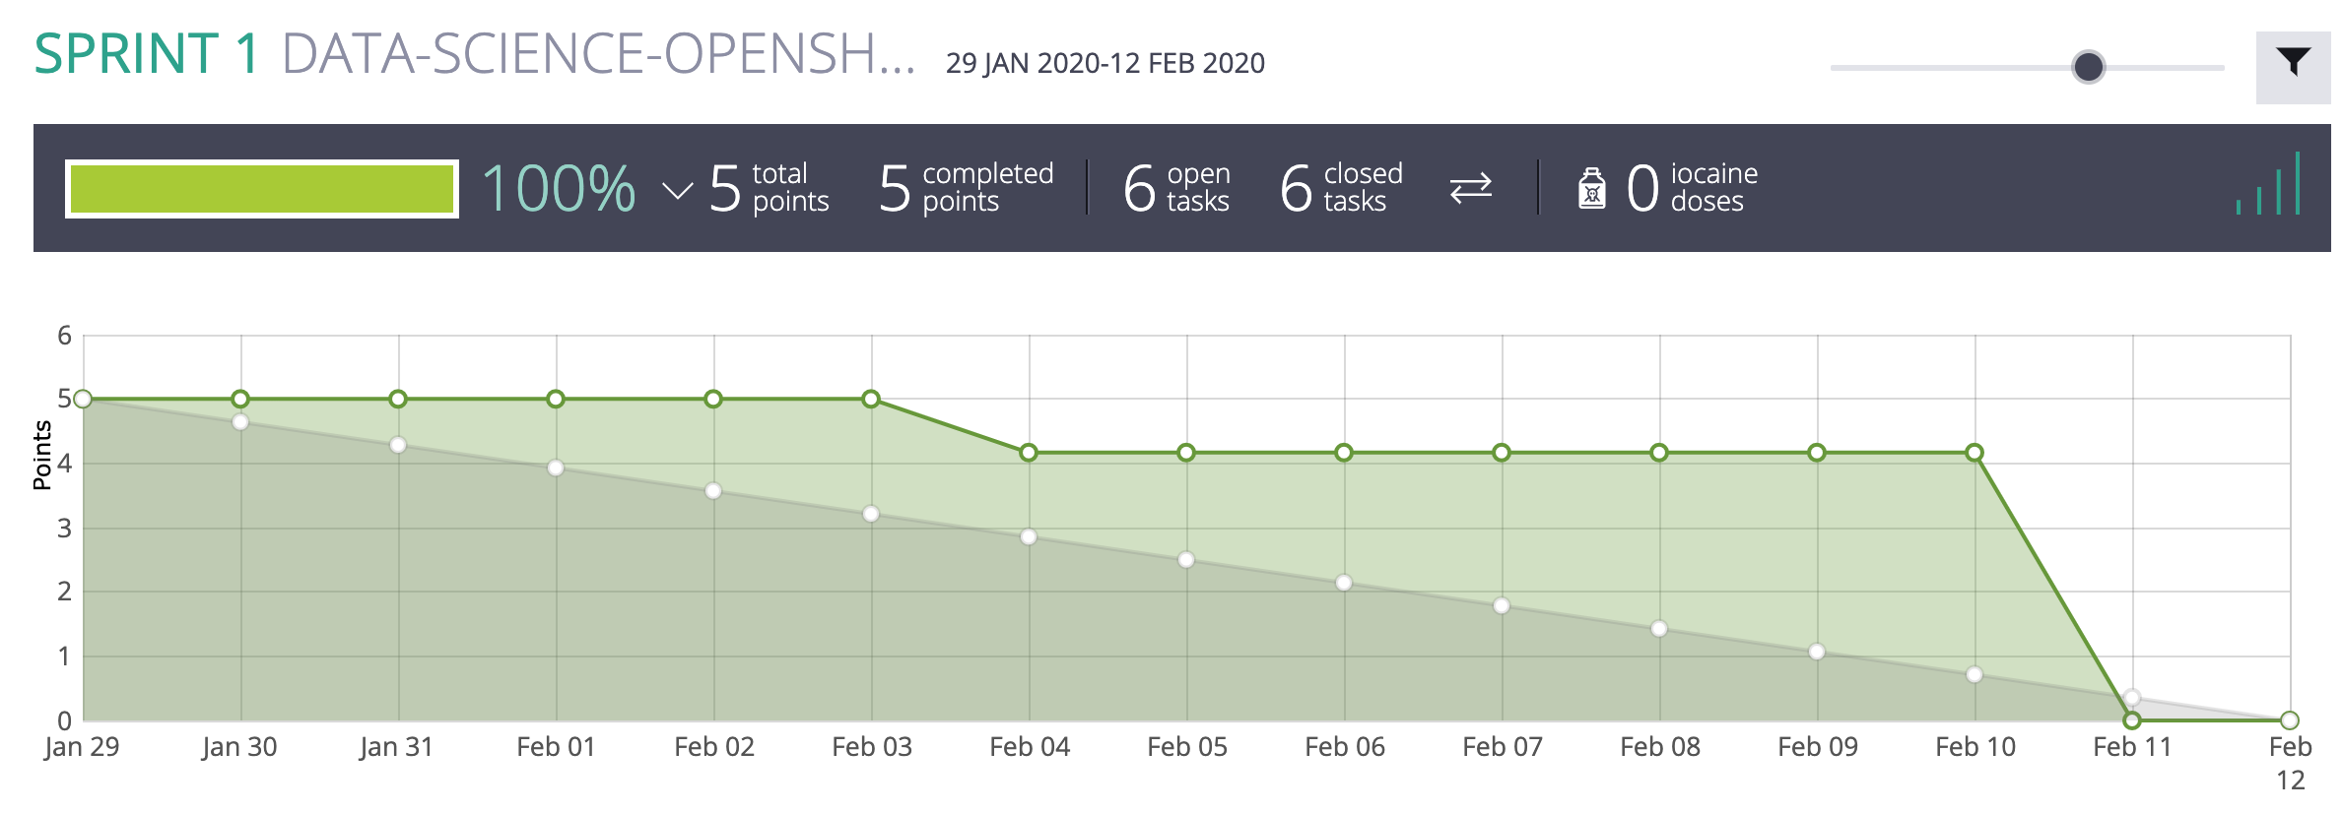
Sprint Progress (Burndown Chart)
Notes:
Nihar

Slide 11

Next Sprint
Installing DataHub on our local environments and getting acquainted with it
Understanding and reviewing the PAD project
Getting on the MOC
https://www.atlassian.com/agile/scrum/sprints
Notes:
Yousif

Slide 12
Questions
Notes:
Yousif

